Slide 1
Computer Vision
Part 1: Classic Image Segmentation
ADF

Slide 2

Agenda
Part 1: Classic Image Segmentation
Thresholding, Region, Clustering
Part 2: Modern Image Segmentation
Semantic Segmentation
Instance Segmentation
Computer Vision

Slide 3
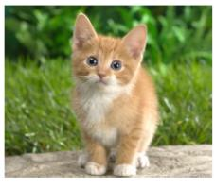
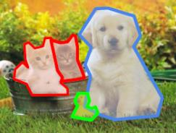
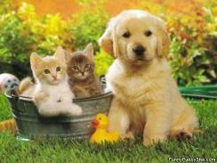
Computer Vision Tasks
Classification
+ Localization
Instance
Segmentation
Classification
Object Detection
CAT
CAT
CAT, DOG, DUCK
CAT, DOG, DUCK
Single Object
Multiple Objects
Computer Vision

Slide 4
Computer Vision Tasks
Classification
+ Localization
Instance
Segmentation
Classification
Object Detection
Computer Vision

Slide 5
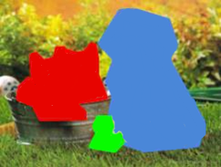
Computer Vision Tasks
Classification
+ Localization
Instance
Segmentation
Classification
Object Detection
Computer Vision

Slide 6
Image Segmentation
Computer Vision

Slide 7
Image Segmentation
Partition an image into a collection of set of pixels
Meaningful regions (coherent objects)
Linear structures (line, curve, …)
Shapes (circles, ellipses, …)
Computer Vision

Slide 8
Image Segmentation
One of the oldest and most widely studied problems
Regarding of its implementations
Thresholding-based
Region-based
Clustering-based
Computer Vision

Slide 9
Basic Image Segmentation
partitions an image into regions called segments.
segmentation are connecting pixels by analyzing some similarity criteria: intensity, color, texture, histogram, features, …
Computer Vision

Slide 10
Thresholding-Based Segmentation
Computer Vision

Slide 11
Thresholding: Binarization
Applies often just one global threshold T for mapping a scalar image I into a binary image
Computer Vision

Slide 12
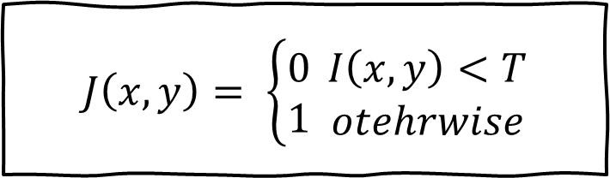
Thresholding: Binarization
The global threshold can be identified by an optimization strategy aiming at creating “large” connected regions and at reducing the number of small sized regions, called artifacts
Brighter objects
Darker objects
$$J\left(x,y\right)= \left\{\begin{aligned}0 \\ 1\end{aligned}\right. \begin{matrix}I\left(x,y\right)<T \\ otehrwise\end{matrix}$$
Computer Vision

Slide 13
Thresholding: Binarization
Original Image
Threshold-ed Image
Threshold Too Low
Threshold Too High
Computer Vision

Slide 14
Thresholding: Binarization
Computer Vision

Slide 15
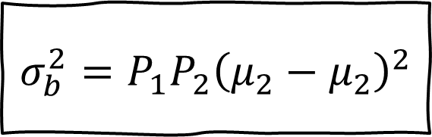
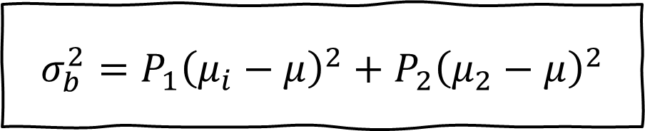
Thresholding: Otsu
Use grey-value histogram of the given image
Aims to provide the best threshold that maximizes the between-class variance
$$σ_{b}^{2}=P_{1}{\left(μ_{i}−μ\right)}^{2}+P_{2}{\left(μ_{2}−μ\right)}^{2}$$
$$σ_{b}^{2}=P_{1}P_{2}{\left(μ_{2}−μ_{2}\right)}^{2}$$
Computer Vision

Slide 16
Thresholding: Otsu
Computer Vision

Slide 17
Region-Based Segmentation
Computer Vision

Slide 18
Region-Based Segmentation
A group of connected pixels with similar properties
Closed boundaries
Regions may correspond to Objects in a scene or parts of objects
Spatial proximity + similarity
Computer Vision

Slide 19
Region-Based Segmentation
Region Growing:
Grow the area of segmentation form a seed point and add recursively adjacent pixels that satisfy a “similarity criterion”
Region Splitting:
Starts with the whole image as a single region and subdivides it into subsidiary regions recursively while a condition of homogeneity is not satisfied.
Region merging:
Region merging is the opposite of splitting, and works as a way of avoiding over segmentation
Computer Vision

Slide 20
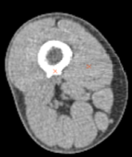
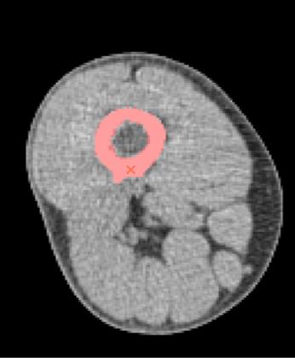
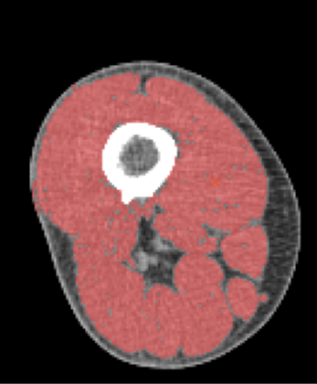
Region-Based: Seeded/Region Growing
Computer Vision

Slide 21
Region-Based: Splitting and Merging
Computer Vision

Slide 22
Clustering-Based Segmentation
Computer Vision

Slide 23
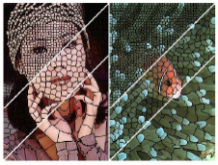
Clustering-Based: K-Means (SLIC)
Features: Lab color, x-y position
Initialize cluster centers in S pixel grid
Move centers to position in 3x3 window with smallest gradient
Compare each pixel to cluster center within 2S pixel distance and assign to nearest
Recompute cluster centers as mean color/position of pixels in each cluster
Stop when residual error is small
Computer Vision

Slide 24
Clustering-Based: Mean-Shift
Variant of an iterative steepest ascent method
Seek stationary points (i.e., peaks) in a density function, which is applicable in many areas of multi dimensional data analysis.
Computer Vision

Slide 25
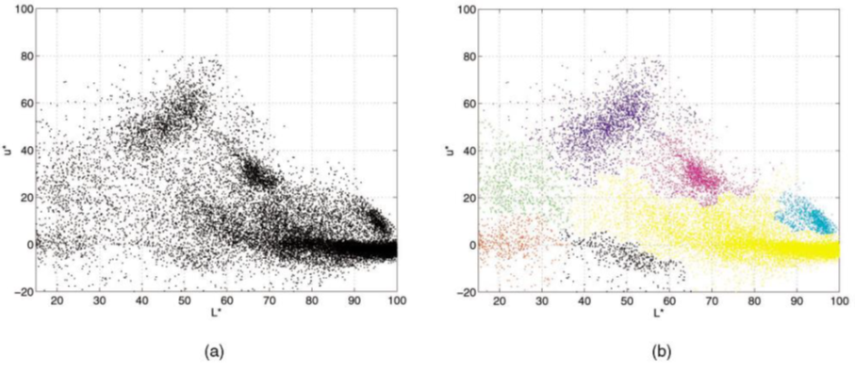
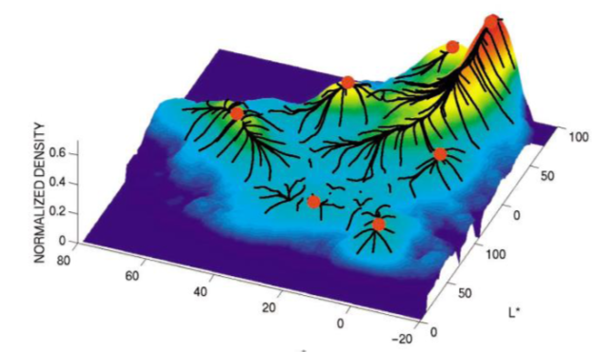
Clustering-Based: Mean-Shift
Attempts to find all possible cluster centers in feature space
Use modes or local maxima of density as a kernel for determining the weight of nearby points for re estimation of the mean.
Computer Vision

Slide 26
Clustering-Based: Mean-Shift
Computer Vision

Slide 27

Break, Question?
Computer Vision

